Slide 1
Predicting Commercial Rent Growth in Canada
Rommel Agustin
500884909

Slide 2
Amazon acquired Whole Foods in 2017
Alarm bells sounded; “retail apocalypse”
Disruption of retail not just grocery with online shopping as it did with department stores and other brick and mortar operations
Investors wary of investing in companies with this exposure

Slide 3
Pandemic 2020
Lockdowns
Businesses with limitations of access to space, closed for months or had limited transactions
Retail tenants accelerated their e-commerce businesses and online presence
Retail landlords faced unpaid rents or worse, permanent closures of some of its tenant’s businesses

Slide 4
Revived the questions in the retail industry such as, is there a need for physical space and are the current market rents reasonable?
Does population and household growth impact retail rent growth?

Slide 5
Other Research
Very few on commercial retail rents and more on housing market rent
Hiebert¹ concluded a positive relationship of immigration and refugees as factors in assessing growth for housing prices and rent levels in Montreal, Toronto and Quebec
Fine tuning of traditional linear regression model in predicting house prices using Bayesian spatially varying coefficient models and geographically weighted linear regression for estimation of hedonic prices by Wheeler²

Slide 6
Other Research
Focused on other than household income and population growth
Tenant mix and retail rent have a positive relationship in the shopping districts according to Zhang³ . With higher foot traffic, higher turnover for goods of tenants. Tenants then are willing to pay higher rents
Des Rosiers, Theriault and Lavoie⁴ focused on extent of impact on rent levels of retail concentration at regional and super-regional shopping centres and categories of goods in 2 Canadian cities

Slide 7
Data source
Statistics Canada
4 datasets
Population 2016 (with 2011)
Population 2011 (with 2006)
Household income (2015 and 2005)
Commercial Rent (2006 to 2021)

Slide 8
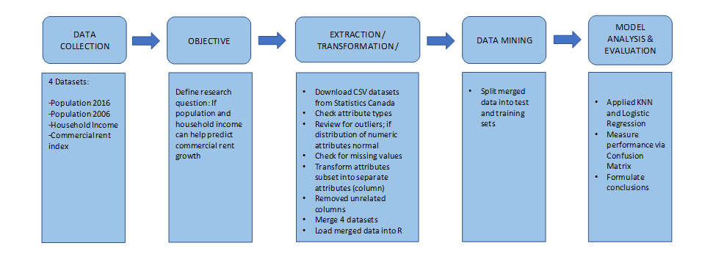
Methodology

Slide 9
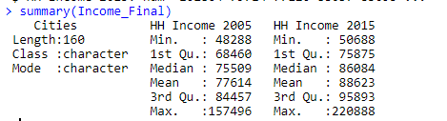
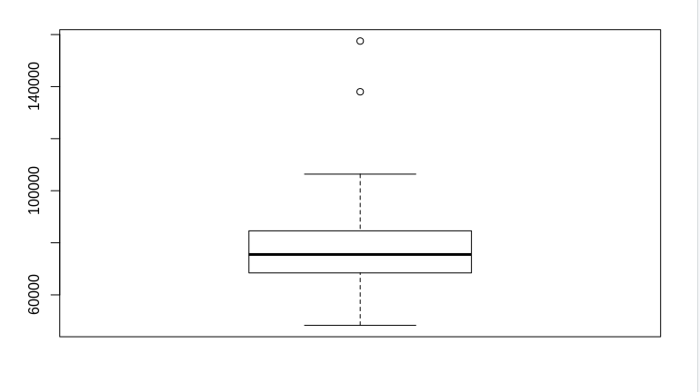
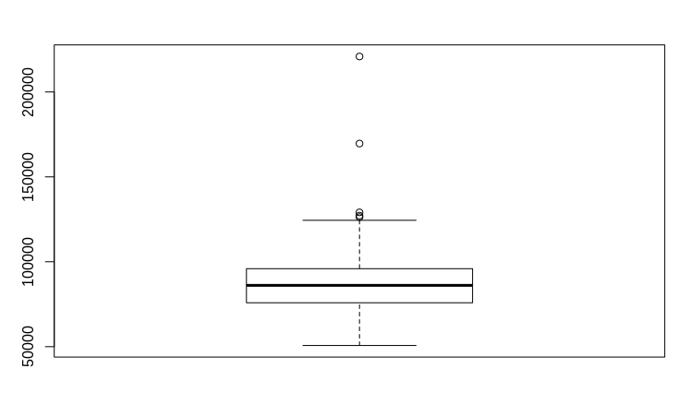
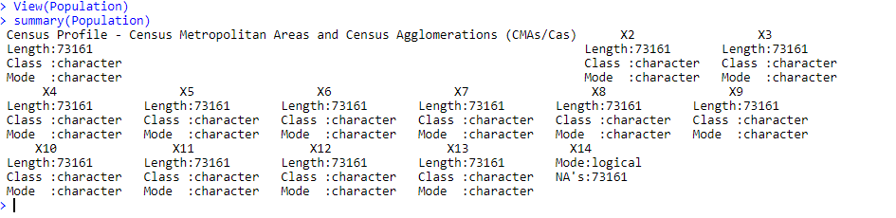
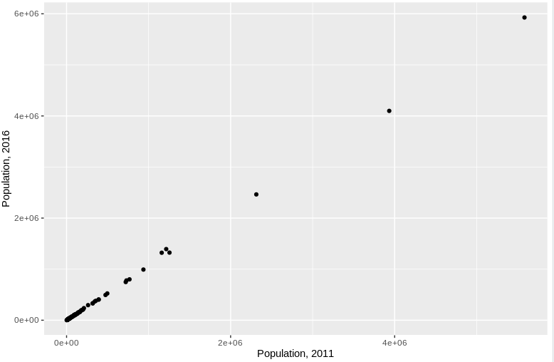
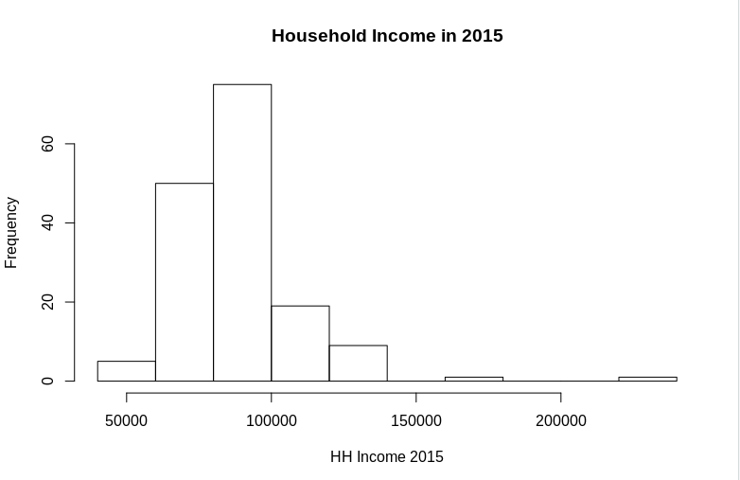
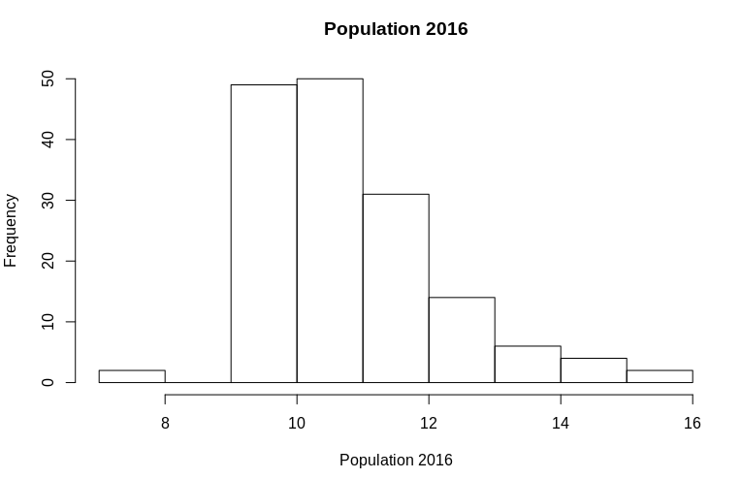
Data pre-processing
Review for outliers
2015 Household income
2005 Household income
Population datasets
Validation of distribution, finding correlations and patterns
Missing values
Transforming (i.e., rows to columns, names change, etc.) and data reduction

Slide 10
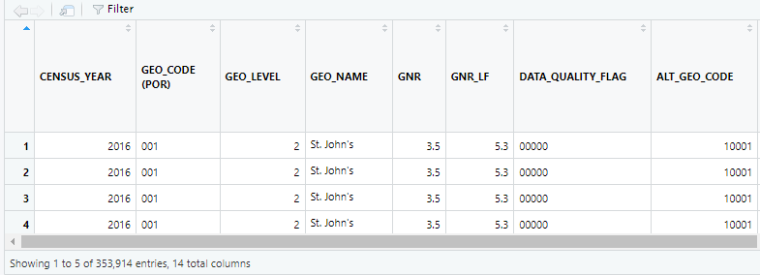
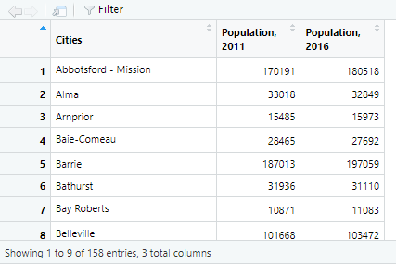
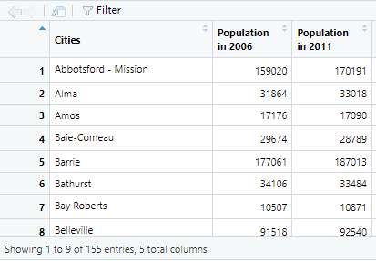
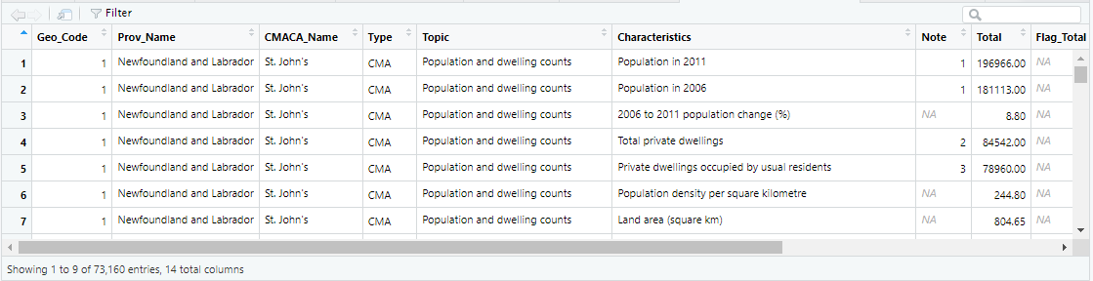
Datasets Cleaned-Up and Integrated
1. Population 2016 and 2011 dataset
Revised dataset “Pop2016Final” with 158 observations and 3 variables from original dataset of 353,914 observations and 14 variables
2. Population 2011 and 2006 dataset
Revised dataset “Pop06_11Final” with 155 observations and 3 variables from original dataset of 73,160 observations and 14 variables

Slide 11
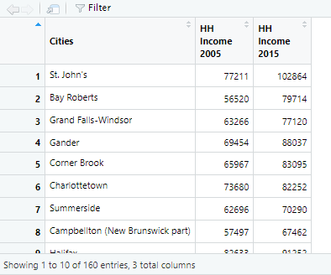
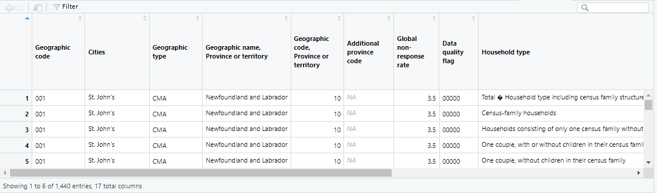
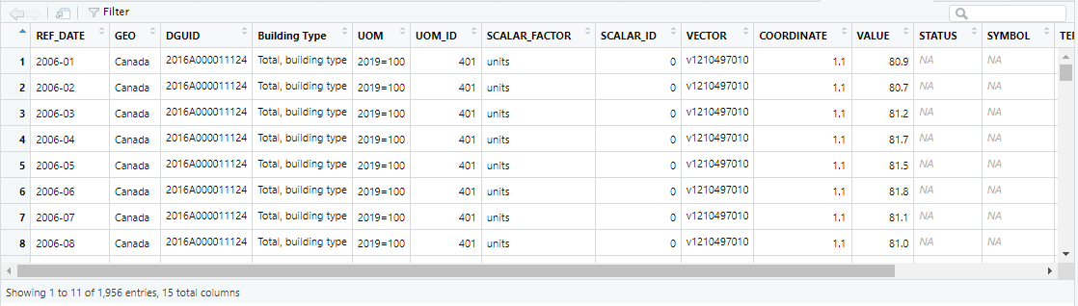
Datasets Cleaned-Up and Integrated
3. Household income 2015 and 2005 dataset
Revised dataset “Income_Final” with 160 observations and 3 variables from original dataset of 1,440 observations and 17 variables
4. Commercial rents dataset
Revised dataset “RentSubset3” with 390 observations and 4 variables from original dataset of 1,956 observations and 15 variables

Slide 12
Data integration
Singular list showing metrics of population, household income and rents in one dataset, 4 dataset were consolidated (via merge in R)
Left join on Population 2016 with Population 2011 to get Revised Population (both datasets with 158 observations)
Left join on Household income (with 160 observations) with Revised population to get Combined Population and Household income (dataset with 160 observations)
Left join on the Combined Population and Household income with Rent

Slide 13
Consolidated dataset issue
Rent dataset to the combined Population and Household Income:
Rent dataset had 390 observations but only included 12 cities for the pertinent year required and remaining were zeroes
Rent = dependent variable
Further reduction: 12 observations and 4 variables

Slide 14
Addressing the consolidated dataset issue
Went back and explored raw data set for any other data that can be used.
Considered using other data sources from other real estate companies and/or research agencies
However for this project, only public datasets are allowed. Proceeded to do modeling and evaluation with said dataset. At the point of discovery, too late to change theme and datasets

Slide 15
Modeling: k-Nearest Neighbours and Logistic Regression

Slide 16
k-Nearest Neighbours Model
To determine if there is a pattern for rent growth relating to changes in population and household income growth
Normalized numeric variables as Population, Household income and Rent Growth
70 : 30 training and test split
Ran prediction
Prediction resulted in error due to the small number of observations in the consolidated dataset further split in training and testing

Slide 17
Logistic Regression Model
To determine relationship between Rent (dependent variable) and both Population and Household income (independent variables)
Binomial logistic regression: observations in rent growth either increase (“1”) or decrease (“0”)
70 : 30 training and test split
Ran 2 predictions: one with test dataset and one with unsplit data to see impact of more data

Slide 18
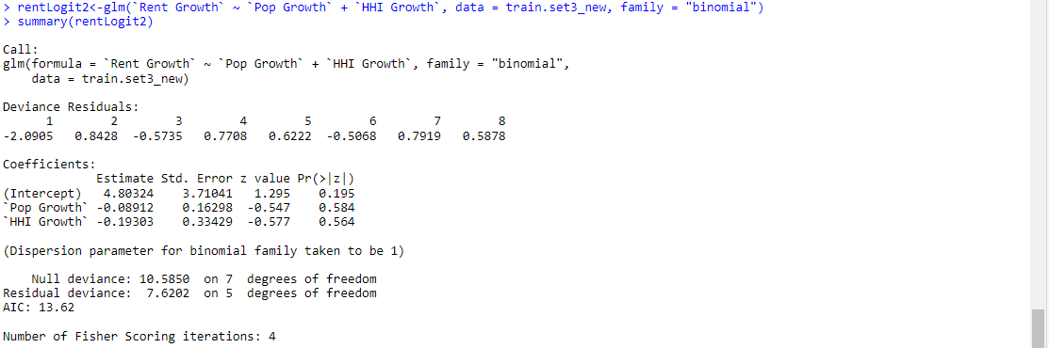
Logistic Regression 1: with Test Set
Coefficients:
For every unit change in population growth, the log odd of rent growth decreases by 0.089
For every unit change in household income growth, the log odd of rent growth decreases by 0.193
Population growth (p-value = 0.584) and Household income growth (p-value = 0.564) are not statistically significant in relation to rent

Slide 19
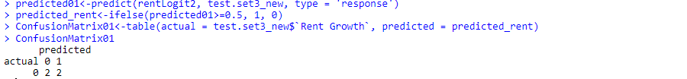
Logistic Regression 1: with Test Set
Model evaluation using Confusion Matrix:
The test set carried solely “0” or decrease in growth. Results of the prediction show 50 : 50 probability of between True Negative and False Positive

Slide 20
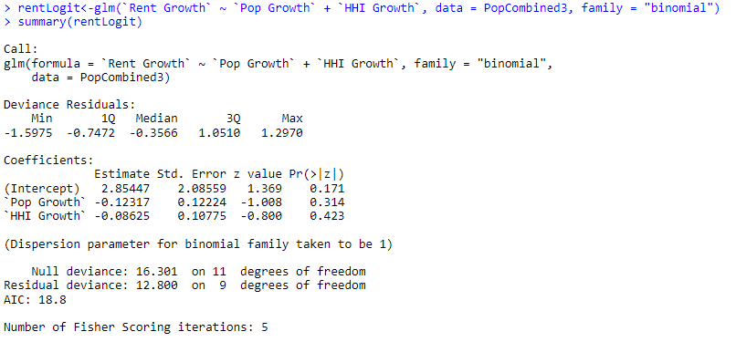
Logistic Regression 2: unsplit data
Coefficients:
For every unit change in population growth, the log odd of rent growth decreases by 0.123
For every unit change in household income growth, the log odd of rent growth decreases by 0.086
Population growth (p-value = 0.314) and Household income growth (p-value = 0.423) are not statistically significant in relation to rent

Slide 21
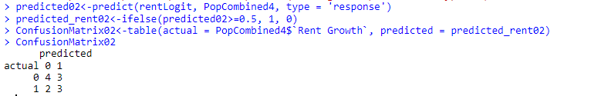
Logistic Regression 2: unsplit data
Model evaluation using Confusion Matrix:
Now with additional “1” or increase rent occurrence
Accuracy increased to 58% from 50% (logistic regression 1)
Able to predict decrease when truly a decrease 57% of the time (specificity)
Able to predict increase when truly an increase 60% of the time (sensitivity)
Able to predict increase 50% of the time (precision)

Slide 22
Conclusion and Limitation
Based on the results of Logistic Regression, there is an indirect relationship between Population and Household income to rent which is for a unit increase in population or household income there is a commensurate decrease in rent growth
Limitation: Results are inconclusive due to data imbalance used to train and test our information
Expanding/adding to the rent data (logistic regression 2) further improves the performance of the model and will provide more insights into predicting rent growth using population and household income growth

Slide 23
Next Steps
Pursue filling in missing rent data by reaching out to research organizations as CBRE, JLL, Colliers, among others. We are confident that the model will yield more meaningful insights and conclusions once completed

Slide 24
References
Hiebert, D. (2017). Immigrants and Refugees in the Housing Markets of Montreal, Toronto and Vancouver, 2011. Canadian Journal of Urban Research, 26(2), 52. http://ezproxy.lib.ryerson.ca/login?url=https://www.proquest.com/scholarly-journals/immigrants-refugees-housing-markets-montreal/docview/2159615860/se-2?accountid=13631
Wheeler, David C. (2014). A Bayesian approach to hedonic price analysis. Papers in regional science. ISSN: 1056-8190. Volume: 93. Issue: 3 Page: 663 DOI: 10.1111/pirs.12003
Zhang, Song (2020). Tenant Mix and Retail Rents in High Street Shopping Districts. The journal of real estate finance and economics. ISSN: 0895-5638. DOI: 10.1007/s11146-020-09768-3
Des Rosiers, F., Thériault, M., & Lavoie, C. (2009). Retail Concentration and Shopping Center Rents - A Comparison of Two Cities. The Journal of Real Estate Research, 31(2), 165-207.
http://ezproxy.lib.ryerson.ca/login?url=https://www.proquest.com/scholarly-journals/retail-concentration-shopping-center-rents/docview/200319553/se-2?accountid=13631

Slide 25
Thank you

